Slide 1
Title Goes Here and Here and Here
Speaker’s Name, SAP
Month 00, 2019
Partner logo

Slide 2
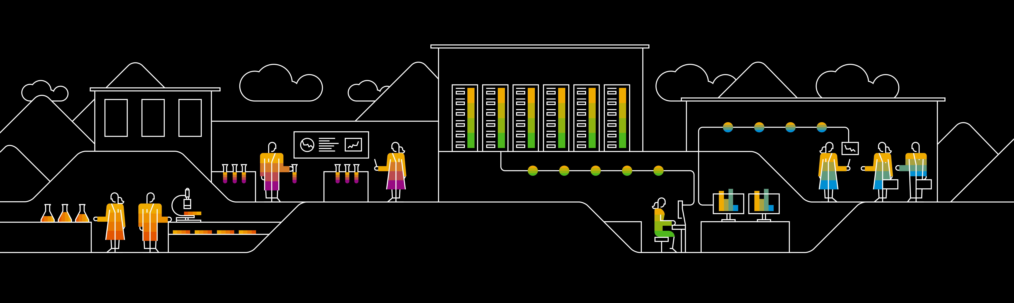
Title Goes Here and Here and Here
Speaker’s Name, SAP
Month 00, 2019
Partner logo

Slide 3
Agenda
What is Machine Learning?
Details
Comparison Between: Data Science, AI, ML, and Deep Learning
Artificial Intelligence
Machine Learning
Deep Learning
Data Science
Agenda item/divider headline
Details
Agenda item/divider headline
Details

Slide 4

What is Machine Learning?

Slide 5
Overview
Artific
Artificial Intelligence
Machine Learning
Data Science
Deep Learning

Slide 6
Artificial Intelligence
“The science and engineering of making intelligent machines, especially intelligent computer programs”.
Some examples of AI:
Health Care (drug discovery, Health Diagnostics)
SIRI, Alexa, Cortana (Digital Assistants)
Self Driving cars (Tesla)
Netflix, Amazon, YouTube, Spotify (Product recommendation)
Chat bots
Image Recognition

Slide 7
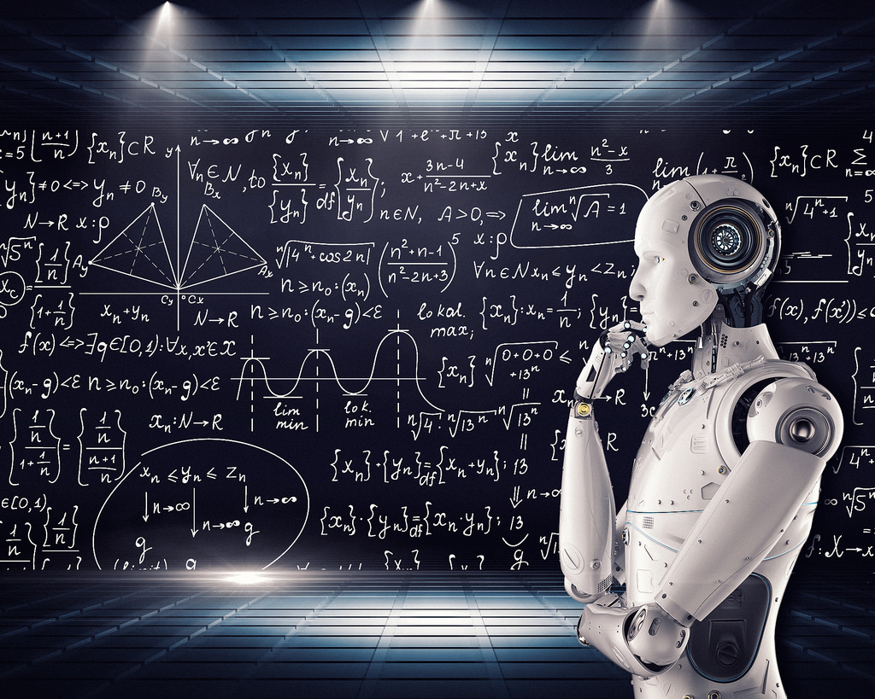
Machine Learning Subheadline
Machine learning is an application of artificial intelligence (AI) that provides systems the ability to automatically learn and improve from experience without being explicitly programmed. Machine learning focuses on the development of computer programs that can access data and use it learn for themselves.
Types of Machine Learning:
Supervised Machine Learning
Unsupervised Machine Learning
Reinforcement Machine Learning

Slide 8
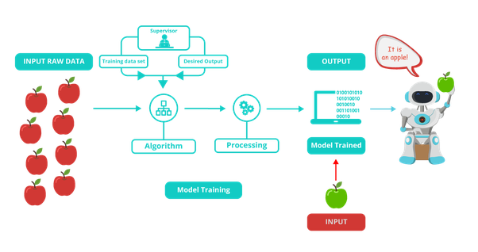
Supervised Learning

Slide 9
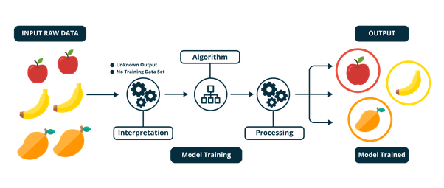
Unsupervised Learning

Slide 10
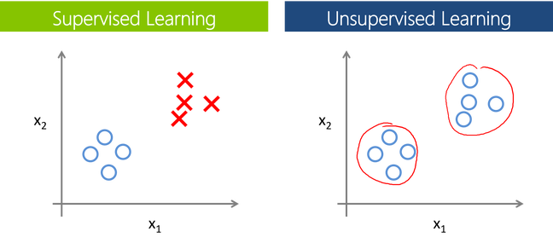
Supervised vs Unsupervised

Slide 11
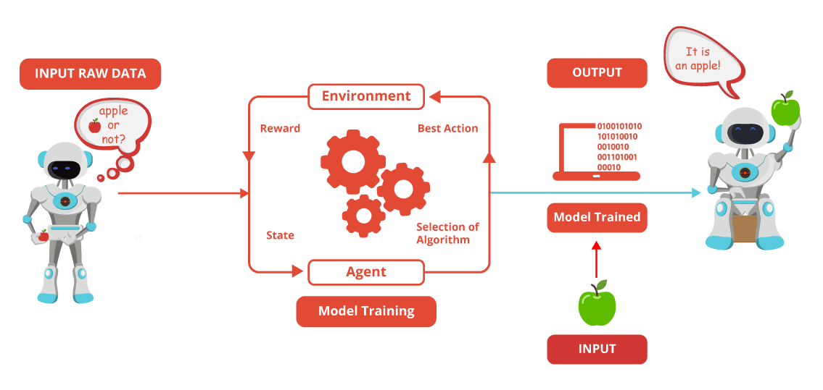
Reinforcement Learning

Slide 12
Deep Learning
Deep Learning is a subfield of machine learning concerned with algorithms inspired by the structure and function of the brain called artificial neural networks.
Both machine and deep learning are subsets of artificial intelligence, but deep learning represents the next evolution of machine learning. In machine learning, algorithms created by human programmers are responsible for parsing and learning from the data. They make decisions based on what they learn from the data. Deep learning learns through an artificial neural network that acts very much like a human brain and allows the machine to analyze data in a structure very much as humans do.
Examples:
Customer Experience, Translations, Computer Vision, Image caption generation,

Slide 13
Data Science

Slide 14
Thank you.
Contact information:
F name L name
Title
Address
Phone number
Partner logo

